Slide 1
Introduction to C#.NET
Notes:
Module 1: Getting Started with Databases and Transact-SQL in SQL Server 2008
Course 2778A
Presentation: 60 minutes
Lab: 60 minutes
This module helps students to : get started with databases and transact-SQL in SQL server 2008.
After completing this module, students will be able to:
Understand SQL Server 2008
Understand SQL Server Databases
Understand the SQL Language
Understand syntax Elements of T-SQL
Work with T-SQL Scripts
Use T-SQL Querying Tools
Required materials
To teach this module, you need the Microsoft Office PowerPoint® file 2778A_01.ppt.
Important It is recommended that you use PowerPoint 2002 or a later version to display the slides for this course. If you use PowerPoint Viewer or an earlier version of PowerPoint, all the features of the slides might not be displayed correctly.
Preparation tasks
To prepare for this module:
Read all of the materials for this module.
Practice performing the demonstrations and the lab exercises.
Work through the Module Review and Takeaways section and determine how you will use this
section to reinforce student learning and promote knowledge transfer to on-the-job performance.
Make sure that students are aware that there are additional information and resources for the module on the Course Companion CD.

Slide 2
C# Overview
C# is a new language created by Microsoft in the year 2000.
C# is a powerful and flexible programming language. Like all programming languages, it can be used to create a variety of applications.
C# was created as an object-oriented programming (OOP) language
C# is a language derived from C and C++.
Many of these features are very similar to what can be found in Java

Slide 3
C# Overview
Features of C#:
  C# is a type-safe, component-based, high-performance language
  it is complete object oriented programming Lang
  it supports structured error handling
  it supports multi threading app development
  it supports interoperability b/w .NET Langs and other .NET supportable langs
  it support generic and collection classes
  it support to develop any type of app like console,windows,web etc.
  Versions:1.0,1.1,2.0,3.0,3.5 ,4.0 and 5.0

Slide 4
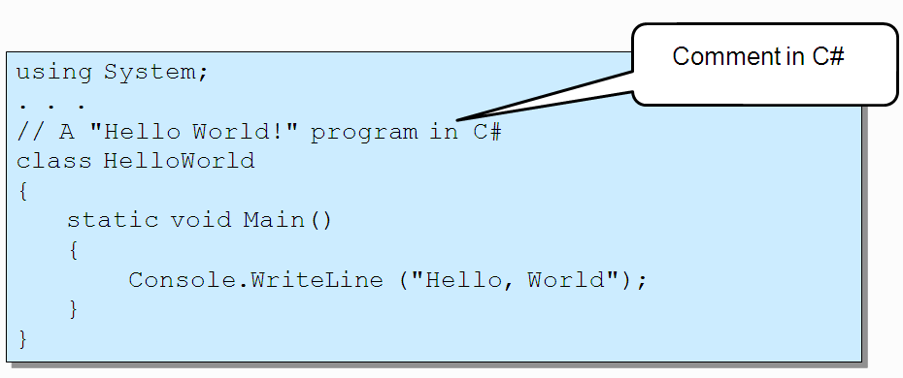
Structure of C# Program
Entry point is Main() function.
The using keyword refers to resources in the .NET Framework class library.

Slide 5
Types
A C# program is a collection of types.
  Classes, structs, enums, interfaces, delegates
C# provides a set of predefined types.
  E.g. int, byte, char, string, object, …
Custom types can be created.
All data and code is defined within a type.
  No global variables, no global functions

Slide 6
Types
Value type
  Directly contain data on stack
Reference type
  Contain reference to the actual object on managed heap.

Slide 7
Types
Value types
  Primitives int num; float speed;
  Enums enum State {Off, On }
  Structs struct Point {int x,y; }
Reference types
  Root object
  String string
  Classes class Line: Shape
  Interfaces interface IDrawble {….}
  Arrays string[] a =new string[10];
  Delegates delegate void operation();

Slide 8
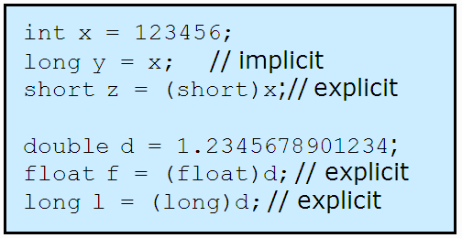
Type Conversion
Implicit conversions
  No information loss
  Occur automatically
Explicit conversions
  Require a cast
  May not succeed
  Information (precision) might be lost

Slide 9
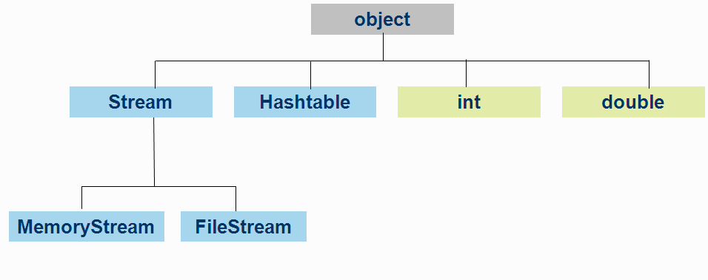
System.Object Class
Everything is an Object.
  All types ultimately inherit from object.

Slide 10
Object Class
Base class for all classes.
Object methods:
  public bool Equals(object)
  protected void Finalize()
  public int GetHashCode()
  public System.Type GetType()
  protected object MemberwiseClone()
  public void object()
  public string ToString()

Slide 11
Boxing
Polymorphic behavior for reference types
  How does an int (value type) get converted into an object (reference type)?
Solution: Boxing!
  Only value types get boxed.
  Reference types do not get boxed.

Slide 12
Unboxing
Opposite operation of boxing
  Copies the value out of the box
    Copies from reference type to value type
Requires an explicit conversion
  May not succeed (like all explicit conversions)
  Essentially a “down cast”

Slide 13
Quick Recap …
C# is type safe Object-oriented programming language.
Main() method is the entry point of a C# program.
Types are either value type or reference type.
Boxing and Unboxing reduces performance of an application.

